Slide 1
Clinic for Rheumatology
and Immunology
Department of Public Health,
Babes-Bolyai University, Cluj Napoca,
Guest Lecture, 11 October 2022
Migrant health professionals during the COVID-19 pandemic:
How to improve health workforce protection and policy learning?
Ellen Kuhlmann & PROTECT project team
Contact:
kuhlmann.ellen@mh-hannover.de

Slide 2
Background
Germany increasingly counts on migrant healthcare workers (HCWs) to respond to growing health workforce shortage.
However, the situation of HCWs during the pandemic is generally poorly monitored and data on migrant HCWs are lacking. Protecting migrant HCWs must be included in pandemic response and preparedness plans.

Slide 3
Introducing the PROTECT project
This interdisciplinary pilot project pays attention to the social dimension of the pandemic.
The study connects health policy/systems and actor-centred approaches. It investigates perceptions and needs of health professions/high-skilled migrant HCWs during the COVID-19 pandemic; we focus on Romanian physicians as the largest group of foreign-born/-trained physicians in Germany.

Slide 4
The aims
The project aims to improve migrant HCW protection and pandemic preparedness and to contribute to effective health workforce policy and European/global responses to HCW shortage and health workforce resilience;
https://www.mhh.de/en/kir/research/project-protect

Slide 5
Collaborating universities

Slide 6
Methods
The study applies a mixed-methods approach and comprises three work packages.
WP1: survey data from two COVID-19 studies gathered at Hannover Medical School.
WP2: in-depth qualitative interviews with Romanian physicians in Germany.
WP3: exploration of policy solutions.

Slide 7
Please note
Work in progress.
Results are preliminary and may change.
Preparedness for leadership | Women % | Men %
very good | 4% | 11%
good | 17% | 33%
sufficient | 44% | 44%
poor | 30% | 0%
very poor | 4% | 11%

Slide 8
Survey data from MHH COVID-19 projects:
DEFEAT (Long COVID)
Data from the DEFEAT project served to compare national-born and foreign-born HCWs.
Selected medical items (e.g. vaccination, SARS-CoV2 infection) and a score (IMET), which combines indicators related to the psycho-social situation, were chosen for comparison.
NO significant differences between national and foreign-born HCWs for medical items and the sample composition.
However, the psycho-social score indicates disadvantages for migrant HCWs.
¹Chi square test, ²Wilcox Test, ³Fisher exact Test

Slide 9
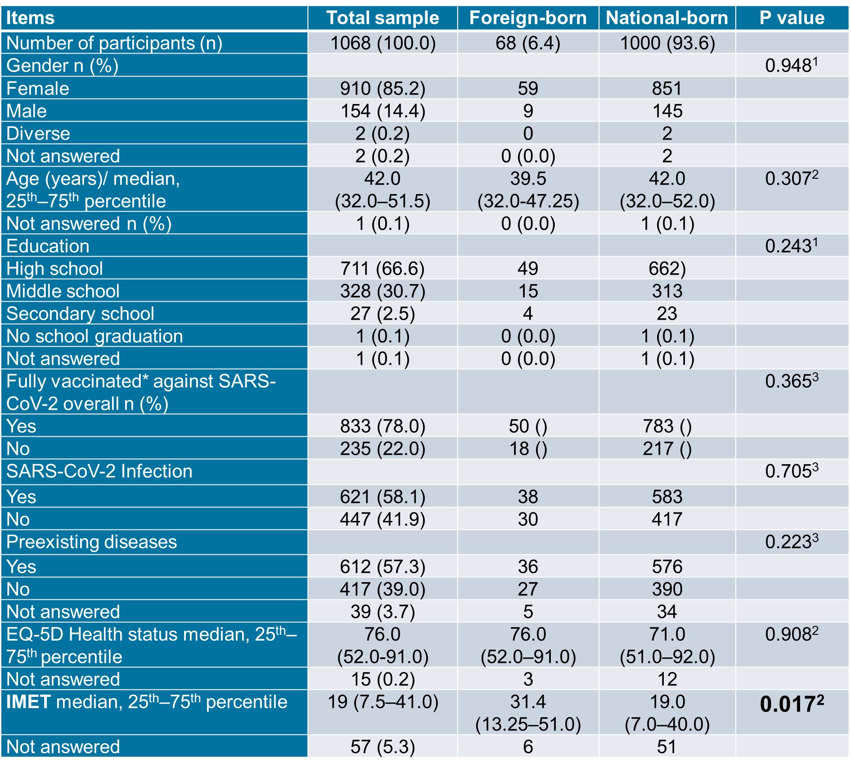
Survey data from MHH COVID-19 projects
Table 1. DEFEAT project, survey data, September 2022
¹Chi square test, ²Wilcox Test, ³Fisher exact Test
Preparedness for leadership | Women % | Men %
very good | 4% | 11%
good | 17% | 33%
sufficient | 44% | 44%
poor | 30% | 0%
very poor | 4% | 11%
¹Chi square test, ²Wilcox Test, ³Fisher exact Test

Slide 10
Results: DEFEAT survey data
Further analysis of the IMET score was undertaken for two items which are relevant for our study.
Social activities: national born 3.514360 (SD 3.245341) vs. foreign-born 4.768116 (SD 3.593887) p=0.004121
Stress/ burdens: national-born 4.403478 (SD 3.080694) vs. foreign-born 5.029412 (SD 3.236778), p=0.1238
Social activities show the strongest differences and disadvantages of migrant HCWs; stress seems to be slightly higher.
¹Chi square test, ²Wilcox Test, ³Fisher exact Test

Slide 11
Survey data from Corona Contact study
(CoCo) at Hannover Medical School
The CoCo study includes HCWs at MHH and combines serum analysis and survey data. Secondary analysis of the survey data is currently undertaken to differentiate between national-born and foreign-born physicians, nurses and other HCWs.
Comparative analysis in progress.
¹Chi square test, ²Wilcox Test, ³Fisher exact Test

Slide 12
Survey data from CoCo
The infection risk at MHH has been very low – largely in the range of the general population in the region – during the first and second wave; this includes HCWs with SARS-CoV-2 patient contact.*
However the HCWs, mainly physicians and nurses, estimated their risk 15-20 times higher than the medically approved risk. Fear of infection and stress scored high, both at the workplace and in the private sphere.
* Results are published; Exploring the gap between healthcare workers’ perceptions and medically approved infection risk. Frontiers Public Health, 2022; DOI:10.3389/fpubh.2022.8980
¹Chi square test, ²Wilcox Test, ³Fisher exact Test

Slide 13
Explorative interviews with foreign-born/ trained physicians from Romania, preliminary findings
12 interviews are currently included in the analysis.
Snowball sampling was used, taking into account diversity in relation to age/work experience in Germany, professional status, eastern/western Germany, gender, children.
Qualitative interviews were carried out in September 2022, based on a semi-structured topic guide.
Preparedness for leadership | Women % | Men %
very good | 4% | 11%
good | 17% | 33%
sufficient | 44% | 44%
poor | 30% | 0%
very poor | 4% | 11%
¹Chi square test, ²Wilcox Test, ³Fisher exact Test

Slide 14
Topic guide (key issues)
Work and employment situation in Germany
Experiences during the COVID-9 pandemic
Reasons for migrating to Germany
Future plans
¹Chi square test, ²Wilcox Test, ³Fisher exact Test

Slide 15
Findings from the interviews
Work and employment situation
The work situation is described as positive or even very positive.
Major problems occurred at the beginning of the work in Germany; “I was thrown into cold water”, lack of training and mentoring.
Problems are caused by strong shortages of healthcare workers.
Participants perceived these problems as “part of the job” and said there is no difference between national and foreign-born physicians.
¹Chi square test, ²Wilcox Test, ³Fisher exact Test

Slide 16
Work and employment situation: discrimination mainly a problem of the private sphere
No discrimination at the workplace and by colleagues was reported; “I never felt disadvantaged or so, moreover I was lucky and got a leadership position very early”.
Discrimination experiences were mentioned in relation to patients and relatives and in the private sphere; these experiences were related to the Eastern parts of Germany.
¹Chi square test, ²Wilcox Test, ³Fisher exact Test

Slide 17
Work and employment situation: education and training systems as problem
One key problem is the lack of practical training of medical students in Romania.
German students obtain a “practical year”, while students in Romania get their approbation immediately after their exams.
This is perceived as a major problem and disadvantage for Romanian doctors.
Internships do not solve the problem, because they do not provide access to training/theoretical education.
¹Chi square test, ²Wilcox Test, ³Fisher exact Test

Slide 18
COVID-9 pandemic: perceptions
Strong perception that COVID-19 affected everybody in the same way.
Personal protective equipment was perceived as overall good; “the employer cared for us, in the range of their possibilities”.
Vaccination was usually perceived as a big relieve and ‘game changer’, but there were also more critical perceptions related to mandatory vaccination for HCWs in Germany.
Interview material supports findings from the survey.
¹Chi square test, ²Wilcox Test, ³Fisher exact Test

Slide 19
Reasons for moving/ migrating to Germany
Reasons are complex, but two issues emerged.
The pull factors
Better opportunities for professional development and career changes, especially for young physicians, in Germany.
High-tech medicine and medical standards and opportunities to improve medical knowledge and technical skills.
An important issue is the residency training and the freedom of choice of the medical speciality.
¹Chi square test, ²Wilcox Test, ³Fisher exact Test

Slide 20
Reasons for moving/ migrating to Germany
Reasons are complex, but two issues emerged.
The pull factors
Better opportunities for professional development and career changes, especially for young physicians, in Germany.
High-tech medicine and medical standards and opportunities to improve medical knowledge and technical skills.
An important issue is the residency training and the freedom of choice of the medical speciality.
¹Chi square test, ²Wilcox Test, ³Fisher exact Test

Slide 21
Reasons for moving/ migrating to Germany
The push factors
Poor career opportunities in Romania and lack of transparency and fairness of promotion.
Lack of opportunity to choose a specialty.
High corruption in all areas of the healthcare system in Romania.
“There is the son of a chief physician and he gets the job, although I am better qualified, and then I am waiting five years and there is another relative who is outflanking me”.
¹Chi square test, ²Wilcox Test, ³Fisher exact Test

Slide 22
Future plans
The future plans are highly diverse; professional and employment conditions are only one of the reasons for either staying or leaving.
The wider migration pattern and the living conditions are important factors, including family relations, socio-cultural context and political conditions, etc.
A feeling of responsibility for improving healthcare provision in Romania may also matter; “giving my country a chance”.
Notably, money is not the key factor for a decision for staying or leaving.
¹Chi square test, ²Wilcox Test, ³Fisher exact Test

Slide 23
Migration patterns, some preliminary observations
Four major patterns could be identified
The cosmopolitan (EU/ international) physician
Highly flexible.
These physicians go where they get the best training/work and living conditions.
Professional development, medical-technical standards and fair career chances are key criteria.
Preparedness for leadership | Women % | Men %
very good | 4% | 11%
good | 17% | 33%
sufficient | 44% | 44%
poor | 30% | 0%
very poor | 4% | 11%
¹Chi square test, ²Wilcox Test, ³Fisher exact Test

Slide 24
The integrated physician with ‘open future’
These physicians are well integrated and satisfied with their work and life conditions in Germany, but unsure about their future.
“The dream to return home is still there”; “a door to return is kept open”, a physician interested in cross-national employment options.
“I want to give my country a chance”, a physician who returned but perceives this as an experiment and also kept some connections with the German employer.
Preparedness for leadership | Women % | Men %
very good | 4% | 11%
good | 17% | 33%
sufficient | 44% | 44%
poor | 30% | 0%
very poor | 4% | 11%
¹Chi square test, ²Wilcox Test, ³Fisher exact Test

Slide 25
The integrated/ aiming for integration physician
Clear decision to stay in Germany or get German citizenship; difficulties are accepted and perceived as temporary problems; they change the employer but not their aim.
High motivation, investment in training and language skills; high engagement in the job.
“I want to grow together here”; German husband, children do not speak Romanian.
“My mother is here, I wanted to be with her”; “we bought a house here” (with migrant husband).
Preparedness for leadership | Women % | Men %
very good | 4% | 11%
good | 17% | 33%
sufficient | 44% | 44%
poor | 30% | 0%
very poor | 4% | 11%
¹Chi square test, ²Wilcox Test, ³Fisher exact Test

Slide 26
Work and employment conditions are NOT necessarily the key factors for staying or leaving Germany.
An increase in racisim and right-wing populist parties in Germany (AfD/ Alternative for Germany) were perceived as the ‘red line’.
“If the future of my child is at risk”, they would return to Romania, despite a strong wish for integration.
Preparedness for leadership | Women % | Men %
very good | 4% | 11%
good | 17% | 33%
sufficient | 44% | 44%
poor | 30% | 0%
very poor | 4% | 11%
¹Chi square test, ²Wilcox Test, ³Fisher exact Test

Slide 27
The ‘wishing to return’ /
‘belonging to Romania’ physician
The wish to return to Romania is very strong, even if the work situation and support of colleagues are perceived as very good.
The major reason is a feeling of ‘belonging’ to Romania, including strong religious belief.
“My suitcase is packed, every day I would return”, it only depends on her (Romanian) husband, who does not plan to return to Romania but considers moving to other European countries.
Preparedness for leadership | Women % | Men %
very good | 4% | 11%
good | 17% | 33%
sufficient | 44% | 44%
poor | 30% | 0%
very poor | 4% | 11%
¹Chi square test, ²Wilcox Test, ³Fisher exact Test

Slide 28
Identifying drivers for mobility
Professional development (training and career options), high-quality medical standards and work/ employment conditions are strong incentives to move to Germany.
Poor career options and lack of choice and fairness, as well as widespread corruption in Romania create strong incentives to leave.
Preparedness for leadership | Women % | Men %
very good | 4% | 11%
good | 17% | 33%
sufficient | 44% | 44%
poor | 30% | 0%
very poor | 4% | 11%
¹Chi square test, ²Wilcox Test, ³Fisher exact Test

Slide 29
Identifying opportunities for innovation and transnational European solutions
The ‘cosmopolitan’ and ‘open door’ physicians may provide opportunities for establishing ‘circular migration’ and transnational European employment and training agreements between countries.
Preparedness for leadership | Women % | Men %
very good | 4% | 11%
good | 17% | 33%
sufficient | 44% | 44%
poor | 30% | 0%
very poor | 4% | 11%
¹Chi square test, ²Wilcox Test, ³Fisher exact Test

Slide 30
Discussion

Slide 31
Acknowledgements
GLOHRA team:
Ellen Kuhlmann, Alexandra Dopfer-Jabonka, Marie Mikuteit, Anne Cossmann, Leonie Mac Fehr (Hannover Medical School)
Frank Müller, Nancy Thilo (University Medicine Göttingen)
Marius Ungureanu, Monica Brinzac (Babes-Bolyai University)
Funding
PROTECT is supported by the German Alliance
for Global Health Research –
GLOHRA (https://globalhealth.de/funded-projects.html)
with funds from the German Federal Ministry for
Education and Research – BMBF

Slide 32
Many thanks!

